Slide 1
Module 3 – Flow Control
3: Flow Control
4: String Handling
5: Collections

Slide 2
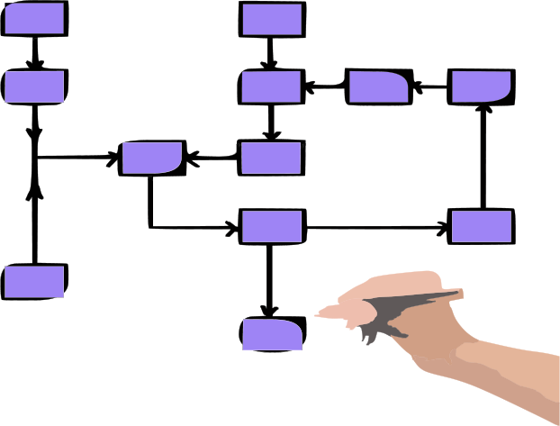
By the end of this chapter, learners will be able to:
Perform decision making using Python conditionals
Understand what truth is?
Use Boolean and Logical Operators
Test collections and sequences
Determine object types
Repeat blocks using loops
Iterate through sequences using iterator loops
Exit programs in good order

Slide 3
Python Conditionals – if statement
Conditional membership is by indentation
Structure and syntax:
Designed for readability
Boolean operators are overloaded by type
No need for different text or numeric operators
Simple examples
score = 72
if score < 50:
print("You failed")
elif score <= 69:
print("You passed")
else:
print("You got an A!")
if condition:
statements
elif condition:
statements
else:
statements
: is mandatory
4 space indentation
n x Optional
1 x Optional
if lista == listb:
print("Same!")
if "eggs" in lista:
print("It eggists!")
Notes:
The syntax for conditional statements in Python is straightforward. A condition ends with a colon (:), and the block of code that follows is defined by consistent indentation. Every line in the block must align with the first indented line. When the indentation changes, the block ends (or Python raises an error if the structure is unclear).
Indentation can use any number of spaces (or tabs), but it must be consistent within the block.
Python supports the usual set of comparison and logical operators: > < == >= <= or and not in
No special operators are needed for built-in types such as strings—Python’s standard operators are already overloaded to handle them.

Slide 4
Python Conditionals – match case
Match Case (introduced in Python 3.10)
Provides a cleaner alternative to long if/elif/else chains
Easier to read and maintain when there are many conditions
http_code = "418"
match http_code:
case "200":
print("OK")
case "404":
print("Not Found")
case "418":
print("Some other problem")
case _:
print("Code not found")
: is mandatory
Extra 4 space indentation
Same as if and elif clauses
Same as else clause
Notes:
Python was often seen as lagging behind other languages in this area, since many had long supported a dedicated match structure. With Python 3.10, this feature was officially introduced, giving developers a clean and readable way to use pattern matching instead of relying on workarounds.
In practice, match becomes especially useful when an if/elif chain grows too vast - typically when you have more than about three elif branches. At that point, pattern matching is clearer and easier to maintain.

Slide 5
Python Conditionals – testing the platform
Conditionals - Testing Platform
Test for system and platform information
Common when scripts need to adapt to the system they run on
Useful for setting file paths and environment variables
Standard library modules: sys and platform
Platform module also provides other information.
import platform
if platform.system() == "Windows":
print("Machine =", platform.machine())
print("Hostname =", platform.node())
print("OS =", platform.platform())
print("Python =", platform.python_version())
import os
import sys
if sys.platform == "win32":
home_dir = os.environ["HOMEPATH"]
else:
home_dir = os.environ["HOME"]
Machine = AMD64
Hostname = DESKTOP-A600EVV
OS = Windows-10-10.0.1.19045-SP0
Python = ‘3.13.1’
win32
linux|linux32
darwin|ios|android
aix|sunos|freebsd
Notes:
A common task in Python scripts is to test which platform they are running on. This is useful for setting up different file paths or environment variables, making the script more portable across systems.
The sys module provides access to system-specific variables and functions that interact with the Python interpreter. Its sys.platform attribute returns a string identifying the current platform, with possible values including linux, posix, win32, cygwin, darwin, and openbsd6.
The platform module offers a higher-level interface; for example, platform.system() returns the operating system name such as Windows. It also provides additional functions to retrieve details like the architecture, machine type, hostname, processor, and even the Python implementation (for example, CPython).
The os module, which provides a variety of operating system interfaces, can also return the OS type using os.name (e.g., nt), although this is less detailed than the sys or platform equivalents, which are usually preferred. All three modules are part of the Python Standard Library.

Slide 6

Python Conditionals - Indentation
Python?
That is for children. A Klingon Warrior uses only machine code, keyed in on the front panel switches in raw binary.
Klingon Programmer
The Future
“We will perhaps eventually be writing only small modules which are identified by name as they are used to build larger ones, so that devices like indentation, rather than delimiters, might become feasible for expressing local structure in the source language.“
Donald Knuth 1974
The Guidelines:
Spaces are the preferred indentation method.
Use 4 spaces per indentation level.
Python does not allow mixing tabs and spaces.
PEP 8
Notes:
The Donald Knuth quote comes from “Structured Programming with go to Statements” (1974). In Python, the standard practice is to use 4 spaces per indentation level, which is widely considered optimal for readability. While the exact number of spaces matters less than being consistent, tabs are generally discouraged because their width varies between editors - what looks aligned in one may appear misaligned in another.
According to the PEP 8 style guide, developers should use four spaces for each level of indentation, never mix tabs and spaces, and only use tabs when maintaining code that already relies on them.

Slide 7
Python Conditionals – what is Truth?
Booleans, Equality, Identity and Membership
bool(x) converts any object to a Boolean using Python’s Truth rules
False : None, False, 0, empty string/tuple/list/dictionary/set
True : everything else and non-empty objects
True and False are built-in Boolean constants
Use == for value equality (override via __eq__ in classes)
Use is for object identity (same object in memory)
Use in/not in for membership
Works on strings, sequences, and sets
Works on dictionary keys (not values)
lang = ["Perl", "Python", "PHP", "Ruby"]
if "Python" in lang:
print("Python is there")
Notes:
Unlike many C-style languages, Python separates statements from expressions: assignment is a statement, so it cannot appear where a Boolean is expected. This prevents the classic mistake of writing = when you meant ==. (Since Python 3.8, the “walrus” operator := allows assignment inside an expression, but its distinct syntax reduces ambiguity and it’s rarely needed in simple conditions.)
The equality operator == compares values and can be overloaded by classes, while is checks object identity (whether two variables refer to the very same object).
The membership operator in tests whether an element occurs in a container - on strings it checks for substrings, on lists/tuples for elements, and on dictionaries for keys. Historically, very early Python 2 releases allowed rebinding True and False; in modern Python 3 they are built-in constants and attempting to assign to them raises a SyntaxError.

Slide 8
Comparison and Boolean Operators
Comparison Operators
Boolean Operators
Operator | Meaning | Example
< | Value less than | expr < expr
<= | Value less than or equal | expr <= expr
> | Value greater than | expr > expr
>= | Value greater than or equal | expr >= expr
== | Value equality | expr == expr
!= | Value inequality | expr != expr
Is | Object identity is the same | expr is expr
not | Logical NOT | not expr
and | Logical AND | expr and expr
or | Logical OR | expr or expr
Notes:
Python’s comparison and logical operators behave much as in other languages, but comparisons are type-aware: operators like ==, !=, <, >, <=, >=, and in work with numbers, strings, lists, dictionaries, and most custom classes via their rich-comparison methods.
In Python 3, ordering comparisons between unrelated types (e.g., list < dict) raise a TypeError, while equality across different types is allowed but usually returns False (with numeric types interoperating as expected, e.g., 1 == 1.0). The odd one out is is, which checks object identity (same object in memory), not value equality—use == for values, is for identity.
For history: Python 2 supported the <> not-equal operator and a cmp() built-in; both are gone in Python 3 - use != and rich comparisons instead.

Slide 9
Chained Comparisons
Consider a test with multiple related expressions:
Number must be between 0 and 41 and distance must be above 42:
Could be rewritten as a chained comparison:
And can be combined with other tests:
if 0 < number and number < 42 and 42 < distance:
print("number and distance are within range")
else:
print("number and distance are out of range")
if 0 < number < 42 < distance:
print("number and distance are within range")
else:
print("number and distance are out of range")
if 0 < number < 42 and distance != 20:
Notes:
Chained comparisons are a handy way to write range-style conditions in if and while statements. Instead of x > 0 and x < 10, you can write 0 < x < 10. Python evaluates these left-to-right with short-circuiting and evaluates the middle expression only once. You can mix operators like <, <=, ==, !=, and > (e.g., a < b <= c). Use chained comparisons only when they improve readability - remember the Zen of Python: “Readability counts.”

Slide 10
Sequence and Collection Tests
An empty string, tuple, list, dictionary, set returns False:
Sequences also support built-in functions all() and any():
all()returns True if all items in the sequence are true.
any()returns True if any of the items in the sequence are true.
mylist = [0, 1, 2, 3]
if mylist:
print("mylist is True")
mylist is True
mylist = [0, 1, 2, 3]
if not all(mylist):
print("mylist: not all are True")
if any(mylist):
print("mylist: at least one item is True")
0 evaluates to False
1 evaluates to True
mylist: not all are True
mylist: at least one item is True
Notes:
An empty list is not the same as a variable that hasn’t been defined. Using an unbound name raises a NameError, whereas a defined but empty container (e.g., []) simply evaluates to False in a Boolean context. The same applies to other built-ins: empty strings '', tuples (), dictionaries {}, and sets set() all exist but are falsy.
Python also provides all() and any() for iterables. all(iterable) returns True only if every element is truthy (and for the empty iterable it returns True by convention); any(iterable) returns True if any element is truthy (and False for an empty iterable).

Slide 11
Object Types
Beware of comparing objects of different types.
Comparison operators may be overloaded.
Do not expect automatic conversion.
num = 42
txt = "3"
if txt < num:
print("Wow!")
else:
print("Doh!")
if int(txt) < num:
print("Wow!")
else:
print("Doh!")
TypeError: unorderable types: str() < int()
Wow!
Notes:
Python’s operators are implemented by type-specific methods, so trouble can arise when you use a binary operator on incompatible types. In older Python versions, some mixed-type comparisons were allowed and produced arbitrary results; in Python 3 these now raise a clear TypeError.
The fix is simple: convert values to the intended type before comparing or combining - e.g., use int(), float(), or str(). Equality can work across types (with sensible rules), but ordering is only defined where it makes sense (e.g., int and float). Python favours explicit conversions over implicit coercions, keeping the syntax simple and behaviour predictable.

Slide 12
Note on Exception Handling
An exception signals something unexpected during execution
If uncaught, it halts the program;
If handled with try/except, you control the outcome
Built-ins and operations raise exceptions to signal specific conditions
Exceptions don’t always mean failure:
They can represent expected cases to handle, for example
Item not found → KeyError, ValueError
File issues → FileNotFoundError, PermissionError
Exception Handling is for a future discussion
int("x")
ValueError: invalid literal for int() with base 10: 'x'
Notes:
The TypeError on the previous slide is just a standard exception, which you can catch and handle. Place code that might fail inside a try block and add an except clause for the specific exception type (e.g., except TypeError as e:) to replace or enrich the error message - optionally directing it to standard error with file=sys.stderr.
try:
if txt < num:
print('Wow!')
except TypeError:
print("Invalid types compared", file=sys.stderr)
If the raised exception doesn’t match any listed handler, Python propagates it up the call stack; an unhandled exception terminates the program with a traceback. You can also use else for code that should run only when no exception occurred, and finally for cleanup that must run regardless of success or failure.
As a best practice, catch the most specific exceptions you expect, avoid blanket except Exception: unless you re-raise or log, and keep handlers small and purposeful. Exception handling is a topic to be discussed in detail later.

Slide 13
While – the conditional loop
Loop while a condition is true
Python only supports entry condition loops
There is no do...while loop
Membership is by indentation
Structure and syntax:
Example loops
pop() removes and returns last item from a list
line = None
while line != "done":
line = input('Type "done" to complete: ')
print("<", line, ">")
i = 0
while i < 10:
print(i, end="")
i += 1
while condition:
statements
statements
0123456789
my_list = [23, 67, 32, 9, 77]
while my_list:
print(my_list.pop() * 2)
154
18
64
134
46
Notes:
Loops in Python follow the same structure as if statements: a condition or header line ends with a colon, and the loop body is defined by consistent indentation. Python provides the usual while loop and a for loop that iterates directly over items in a sequence or any iterable. Unlike some languages, there is no do...while construct—while evaluates its condition before each iteration, so any variables used in the condition must already be defined; otherwise, a NameError is raised
The first example is fairly simple but indicates that the tested variable must already exist. Missing out that initialisation would result in a NameError exception.
The second example loops while the list is true and not empty. We are using the pop() list method (which we shall see later) which removes the last (right-most) item from a list and returns it.

Slide 14
Loop control statements
Loop control statements
continue perform next iteration
break exit the loop at once
pass empty placeholder (do nothing)
The else: clause
Executes when the condition is false, or when the iterator loop finishes
Including when the loop condition is false on entry.
n = 29
d = 2
while d * d <= n: # try divisors up to sqrt(n)
if n % d == 0:
print(n, "is divisible by", d)
break
d += 1
else:
print(n, "is prime") # Run only if condition fails
29 is prime
Notes:
break and continue work in Python much like in C-style languages and many shells. Some style guides discourage them, and it’s true that a well-structured condition often makes them unnecessary. Still, readability comes first: use break/continue when they make the loop’s intent clearer rather than forcing contorted logic.
pass is a no-op placeholder required when the syntax expects a statement, but you have nothing to do—for example, an empty loop body, an if branch you’ll fill later, a bare except you’re intentionally ignoring, or a stubbed class/function definition.
Python’s loop else: clause is also unusual: it runs only if the loop exits without hitting break. In the divisor example, finding a divisor triggers break and the else is skipped; if no divisor is found, the loop finishes normally and the else block runs.

Slide 15
For – the iterator loop
To iterate through a sequence
Often a list or tuple
Loop variable holds a copy of each element in turn
Membership is by indentation
Structure and syntax
Examples
Iterate through numbers
Iterate through command line arguments
sys.argv is a list of the command line arguments
for i in range(10):
print(i)
for var in iterable:
statements
statements
import sys
for arg in sys.argv:
print("Cmd line argument:", arg)
C:\Python>for.py Monday Tuesday Wednesday
Cmd line argument: C:\Python\for.py
Cmd line argument: Monday
Cmd line argument: Tuesday
Cmd line argument: Wednesday
Notes:
In Python, for iterates directly over items from any iterable (lists, tuples, strings, dicts, custom classes), not over a numeric counter by default. Classes participate by implementing the iterator protocol (typically __iter__ returning an iterator with __next__). Prefer for item in iterable to manual indexing - the object’s iterator is optimized for this. The loop variable is just a name bound to each element in turn: reassigning the name won’t change the container, though mutating a mutable element (e.g., a list inside a list) will be reflected in the container. If you need the position as well, use enumerate(iterable) instead of managing your own counter.

Slide 16
For – Iterate through files
To iterate through files in the file system:
Use the glob module
Globbing (global matching) is derived from the UNIX shells
Matches file and directory names using wildcards.
os.path.getsize() returns the size of a file.
import glob
import os
home_dir = "\user\john\"
for file in glob.glob(home_dir, "*.txt"):
size = os.path.getsize(file)
print(file, size, "bytes")
spam.txt 0 bytes
bacon.txt 192 bytes
eggs.txt 56 bytes
tea.txt 200 bytes
Notes:
In Python, for loops work with iterables—objects that yield their elements one at a time. The glob.glob() function returns a list of pathnames matching a pattern, and you can iterate over that list to process each file or directory in turn.
For large result sets, glob.iglob() (iterator glob) provides a lazy iterator so you don’t load all matches into memory at once.

Slide 17
Enumerate
The enumerate() function:
Is used in loops to get index and item together
Works with any iterable (lists, tuples, strings, files, generators)
Yields a two-item tuple (index, item) on each iteration
Optional start sets the first index:
For example, enumerate(items, start=1)
Handy for files and line numbers
for idx, arg in enumerate(sys.argv):
print('index:’, idx, 'argument:', arg)
for nr, line in enumerate(open("python_song.txt"), start=1):
print(nr, line, end="")
1 Some things in life are bad
2 They can really make you mad
3 Other things just make you swear and curse
Notes:
enumerate() is a built-in that yields (index, item) pairs as you iterate, giving you the current position and the element in one pass. It works with any iterable including lists, tuples, strings, bytearrays, generators, and file objects - and defaults to starting at index 0, though you can set a different starting point with start= (e.g., enumerate(items, start=1)).
It’s cleaner than manual counters like range(len(seq)) and is especially handy for line numbers when reading files. (Historically introduced in Python 2.3; the start parameter arrived in 2.6.)

Slide 18
For – counting loop
Using the built-in range() function:
But this maintains its own iterator:
Use a system generated one instead:
But an index is needed to alter the sequence:
range([start], stop[,step])
for i in range(0, len(some_list)):
if some_list[i] > 42: some_list[i] += 1
for i in range(0, len(some_list)):
print(some_list[i])
for num in some_list:
print(num)
for (idx, num) in enumerate(some_list):
if num > 42: some_list[idx] += 1
Notes:
The built-in range() (previously called xrange() in Python2) produces a lazy, immutable sequence of integers – not a list – defined by start, stop and optional step. All arguments musty be integers, can be negative, and the stop value is excluded (up to stop value).
In Python you usually loop over items directly, not by counting. Use range() when you need to do something N times or you actually need indexes.

Slide 19

Zip – Stepping through related sequences
Group elements from sequences in parallel
The zip() built-in returns an iterator of tuples.
Use list() (or similar) to materialize it into a sequence.
Be cautious: converting large iterators to lists can consume significant memory.
Ideal for iterating over multiple sequences in parallel.
farms = ['Home Farm', 'Muckworthy', 'Scales End', 'Brown Rigg']
squirls = [42, 12, 2, 0]
rabbits = [395, 68, 57, 32]
moles = [12, 8, 0, 29]
for f, s, r, m in zip(farms, squirls, rabbits, moles):
print ('Total for', f, ':', s + r + m)
Total for Home Farm : 449
Total for Muckworthy : 88
Total for Scales End : 59
Total for Brown Rigg : 61
Notes:
The zip() built-in function returns an iterator of tuples. Its most common use is with a for loop: when paired with a tuple of loop variables, each variable is assigned the corresponding item from the input sequences. This avoids the need to write a manual, C-style loop with counters.
zip() is also handy in other scenarios. For example, creating a dictionary from parallel lists:
keys = ['Australia', 'Eire', 'France', 'Finland', 'UK', 'US’]
vals = ['Canberra', 'Dublin', 'Paris', 'Helsinki', 'London', 'Washington’]
mydict = dict(zip(keys, vals))
Python 2 vs 3 difference:
Python 2: zip() returned a list of tuples whereas in Python 3 it returns an iterator of tuples, so you need list(zip(...)) to force materialization.
Note: Despite its name, zip() has nothing to do with compression or archive files like the UNIX zip tools.

Slide 20
Conditional Expression
The Ternary Operator
Let’s you choose between two values in a single line of code
No : and elif not allowed:
Beware of precedence and READABILITY
expr1 if boolean else expr2
i= 42
j = 3
if i > j:
print("i gt j")
else:
print("i lt j")
print("i gt j") if i > j else print("i lt j")
print("i gt j" if i > j else "i lt j")
-1 if a < b else (+1 if a > b else 0)
a = 54
answer = a + 5 if a < 42 else 0
answer = a + (5 if a < 42 else 0)
✓
Notes:
A conditional expression lets you choose between two values in a single line of code.
In Python, it replaces the ternary operator (?:) used in C-style languages. Parentheses are sometimes needed to make it clear which part of an expression is conditional - for example, to ensure that only the intended sub-expression is evaluated based on the condition. While conditional expressions should be used sparingly to keep code readable, they are very useful for writing concise code.
They are particularly handy in situations where brevity matters, such as inside lambda functions.

Slide 21
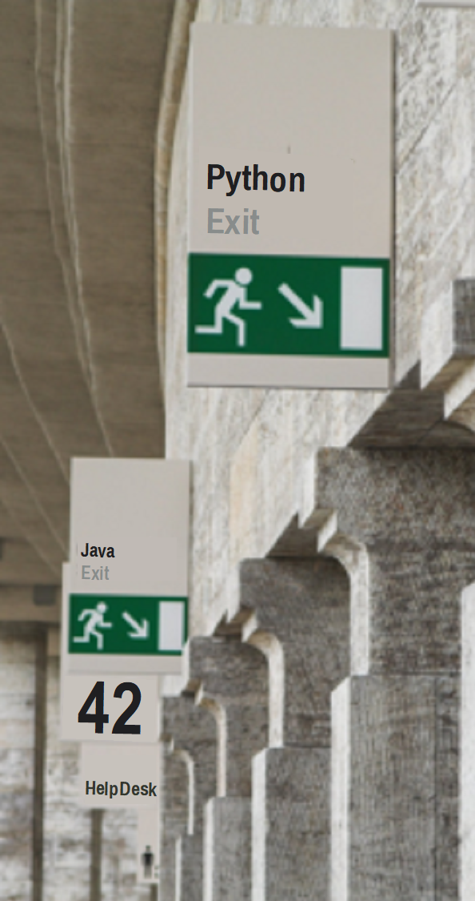
Program Closedown
os._exit(integer_expression)
Exits immediately; cannot be trapped.
Returns integer_expression to the caller (usually the shell).
os.abort()
Raises a SIGABRT signal (can be trapped on UNIX).
On UNIX: causes a core dump.
On Windows: exits with code 3.
sys.exit(expression)
Raises a SystemExit exception which can be trapped.
If expression is an integer → returned to the caller (e.g. shell).
If expression is a string → printed to stderr, and exit code is 1.
sys.exit("Goodbye")
Notes:
The sys.exit() function shuts down the current process, even if called from within another function. Its argument is returned to the caller, which is usually the shell but may also be another application. Many environments (such as UNIX) only support an 8-bit return code, so values should be kept within the range 0–255 for portability. By convention, 0 indicates success. Some standard exit codes are defined in the UNIX version of the os module (prefixed os.EX_), though they are not universally adopted.
Unlike the lower-level os._exit(), which terminates immediately and cannot be trapped, sys.exit() raises a SystemExit exception that can be caught with normal exception handling. This makes it safer for general use, while os._exit() should be reserved for special cases—for example, immediately after a fork() call on UNIX systems. An apparent built-in called exit also exists, but it is actually a site.Quitter object that raises SystemExit. In modern Python there is no practical difference between exit and sys.exit(), though the site module (and therefore exit) can be disabled at startup with the -S option.
If neither exit nor sys.exit() are called, the interpreter returns 0 on normal termination. Python also provides the atexit module, which allows cleanup functions to be run automatically when a program exits (but not when using os._exit()).

Slide 22
Interactive Closedown
Interactive Closedown in Python
What about exit() and quit()?
Created automatically at start-up when the site module is loaded
unless suppressed with the -S option
Behave as follows when called:
Display a short message
Raise a SystemExit exception
Close stdin
In IDLE: SystemExit is ignored, but closing stdin still ends the session
Intended only for interactive use, not production code
Closing stdin has side effects!
>>> exit
Use exit() or Ctrl-Z plus Return to exit
>>> quit
Use quit() or Ctrl-Z plus Return to exit
Notes:
The exit() and quit() functions are not true functions but objects of the site.Quitter class. Their “magic” behaviour comes from the class implementing the special methods __call__ and __repr__ (covered later).
The site module also creates other interactive objects such as copyright, license, and credits, which are instances of the site._Printer class.
According to the Python documentation: “They are useful for the interactive interpreter shell and should not be used in programs.”
Beyond the fact that the site module might not always be loaded, calling exit() or quit() also closes standard input, which can interfere with programs that would otherwise trap the SystemExit exception safely.

Slide 23
Review & Lab
Answer review questions
Your instructor will guide you which lab exercises to complete

Slide 24
Review Questions
In Python, what does an elif clause allow you to do?
Repeat a loop under condition
Handle multiple alternative conditions after an if
Exit a loop immediately
Define an error-handling block
Which of the following loops will execute at least once in Python?
for loop
while loop
Both for and while
Neither – Python has no guaranteed “do-while” loop
Notes:
Answers on next page..

Slide 25
Review Questions
In a for loop, what does Python iterate over?
A sequence of indices
A fixed range of numbers
Each element in the iterable object
Only lists and tuples
What happens when sys.exit(1) is called?
The program ends with success
The program raises SystemExit, which can be caught
The program ignores the call and continues
The program always crashes
Notes:
Correct answers:
What is the correct statement about Python variables?
Handle multiple alternative conditions after an if
Which of the following types is immutable in Python?
Neither – Python has no guaranteed “do-while” loop
What does the += operator do in Python?
Each element in the iterable object
4. What will type("Hello") return?
The program raises SystemExit, which can be caught

Slide 26
Summary
Python Conditionals & Flow Control
Python provides the usual Boolean values (True, False) and logical operators (not, and, or).
Conditions work with many types — be mindful of truthy and falsy values (e.g. 0, "", [] evaluate as False).
Core flow control statements:
A program can be terminated explicitly with sys.exit().
if condition:
# do something
while condition:
# repeat while true
for target in iterable:
# process each item

